Slide 1
Fog-mediated data sharing for IoT platforms
Sponsor - CMU CyLab, Qarnot Computing Points of contact - Yuan Tian, Emmanuel Owusu Faculty Advisor - Patrick Tague
Team - Aditya Subrahmanyan, Sumana Potturu, and Yuehao Yuan

Slide 2
Agenda
● Project overview
Project motivation
Proposed solution/technique
● Design and development
Privacy-preserving machine learning
Speech recognition and query substitution
● Project progress
Project health
Modification of requirements/methodology
● Plan for final report

Slide 3

Internet of Things
Allows sensing, monitoring and control of objects using network infrastructure
Enables integration of physical world into computer systems
Basis for Smart Cities, Smart Homes, Smart Energy Management, etc.
Extremely rapid increase in number of connected devices, aka ‘Things’

Slide 4
Project motivation
Latency and bandwidth
Utility of IoT systems
Data generation
Inferences
Privacy of sensitive data

Slide 5
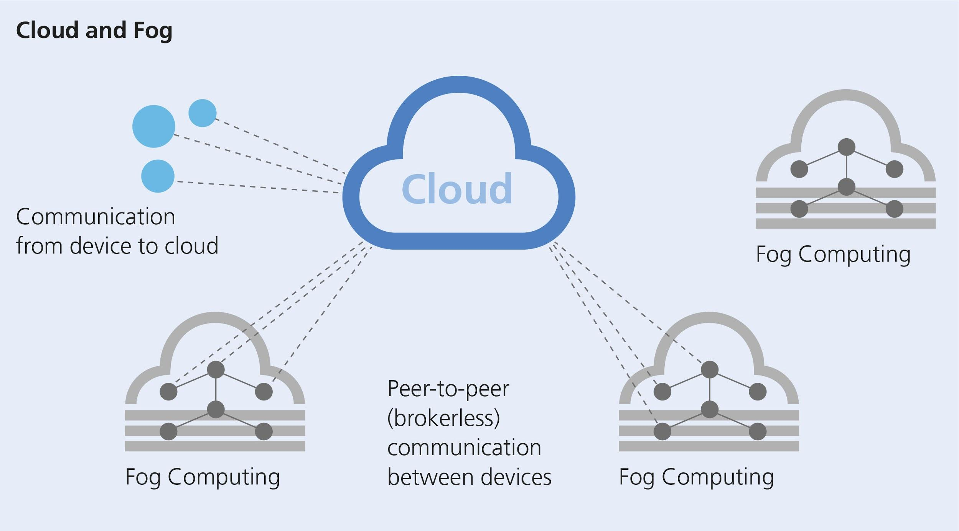
Proposed solution
“Develop and evaluate a fog-computing based, privacy-preserving data-sharing service”
Fog computing
Use network’s edge nodes for computation, storage and networking
Quicker action on sensed data
Avoid complete data exchange with central remote server(s)
Privacy-preserving machine learning
Every node makes ‘smart’ decisions based on the sensed data
Share training model parameters with other nodes without sharing all of the private user data

Slide 6
Proposed solution
Data generation
Fog computing
Latency and bandwidth
Inferences
Privacy-preserving machine learning
Privacy of sensitive data

Slide 7
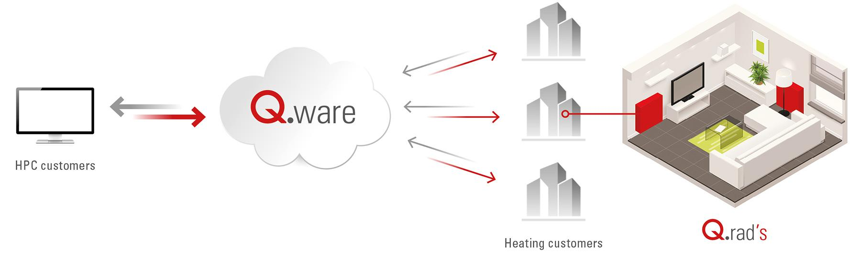
Techniques - Fog computing
Built on Qarnot computing platform
Q.Rad - Fog nodes
Data - Sensor data from Q.Rad
Deploy customized docker instance on Q.Rad’s
Custom profile to orchestrate Q.Rad’s and enable data sharing
Docker Instance

Slide 8



Techniques - Privacy-preserving machine learning
Build a model that produces accurate results
Model should also prevent peer nodes from drawing inferences using the output
Peer nodes modelled as adversary learning models
Interaction between the models and the parameters is used to define the complete system model
Perform query substitution after speech recognition
Replace query-specific words with random words
Send multiple queries to server to prevent actual query identification

Slide 9
Design and development
Deep Learning 101
Deep Learning
A machine learning model consists of several layers
Each layer’s output is input of next layer (except last layer)
Each layer can be described using set of parameters (weight, bias)
Loss Function
Measurement of performance for the model
Train model to minimize loss function
Optimizer
Method to minimize loss function in training process

Slide 10
Design and development Privacy-preserving machine learning
Goal
Build a machine learning model with relatively high accuracy
Prevent adversary restore raw data from intermediate result
Method
Train model locally locally first, then send data to cloud and train remotely
Redefine loss function to add adversary in loss function
Evaluation
Accuracy of the machine learning model (the high the better)
Extent to which adversary can restore our raw data (the low the better)

Slide 11
Design and development Privacy-preserving machine learning
L₁ = L(y, y’; θ₁)
measure of accuracy of user’s model
L₂ = L(x, x’; θ₂)
measure of attacker’s success in reversing raw data
L₃ = - L(x, x’; θ₁)
measure of user’s success in defending against attacker
L = L₁ + L₂ + L₃
Ultimate loss function we want to optimize
y’
cloud
θ1
θ2
Z
Z
local
Attacker
X
X’

Slide 12
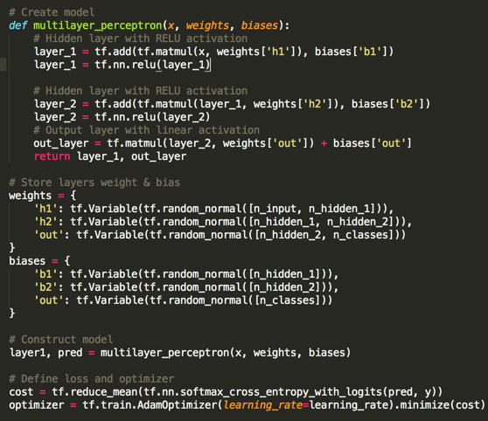
Model Implementation with TensorFlow
Define neural network parameters
Parameter of each layer (weights, bias)
Loss function
Optimizer

Slide 13
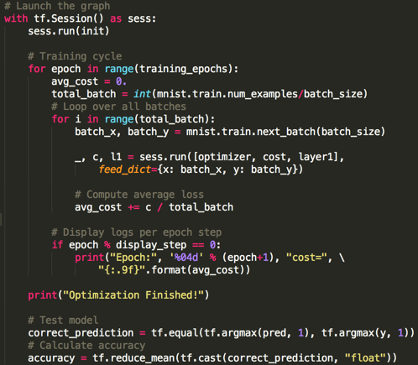
Model Implementation with TensorFlow
Run training and evaluation process
Run training process in several iterations (epoch)
Feed training data to model in each iteration
Test model performance using test data

Slide 14
Design and Development
Query Substitution
Goal:
Build additional queries to send to service provider along with user query
Prevent Adversary/Service Provider to pinpoint the exact user query

Slide 15
Design and Development
Query Substitution
Input
.wav
Speech-Text
CMU-Sphinx
Natural Language Processing
Core-NLP
Create additional Queries
Output
Filter Results for User Query Result
Send Queries to the Server

Slide 16
Design and Development
Query Substitution
Evaluation
Overhead created by the model

Slide 17

Project Progress
On schedule

Slide 18


Project Health
Machine Learning Model
Determine application use case
Explore TensorFlow
Build machine learning model for fog nodes in data-sharing service
Build adversary model
Accuracy evaluation

Slide 19
Project Health
Query Model
Speech to Text Conversion - CMUSphinx
Parse the Query with CoreNLP
Creation of Additional Queries
Build Dataset
Performance Evaluation

Slide 20
Modification of Requirements/Methodology
Machine Learning Model
Build attacker model and design loss function based on the attacker model
Train both machine learning models simultaneously
Integration with Qarnot Platform is stalled due to lack of customized profile
Run on docker instead

Slide 21
Plan for Final Report
Privacy-preserving machine learning algorithm
Build adversary machine learning model (11/20)
Accuracy Evaluation of the machine learning model (11/30)
Query Model
Improve query creation (11/16)
Performance evaluation of the model (11/20)
Final Report

Slide 22


